Slide 1
R for cross-sell modelling
Viktor Tisza
27/10/2018

Slide 2
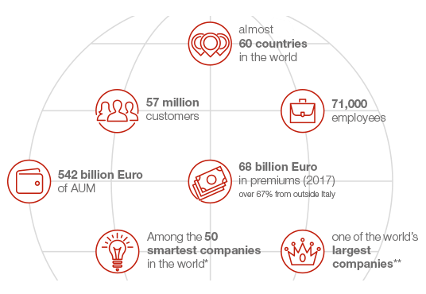

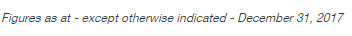
About Generali

Slide 3



About me
Data Scientist at the Analytics Solution Center of Generali
Astrologist confirmed my analysis in the most popular newspaper of Hungary
Long distance runner
Brewing my own beer

Slide 4



What is cross-selling? And why do we need analytics for it?
Cross-selling means selling an additional insurance policy to our existing customers thereby we provide additional solution for customer needs and strenghten our relationship with them
How to avoid targeting people who are not interested?
How to find people who would appriciate the offering?
Predictive modelling can help us to define which customer is likely to be interested in purchaising a certain product
We use results of previous similar campaigns or if not available product ownership as a proxy
It all boils down to a binary classification problem (there can be other approaches too)
?

Slide 5
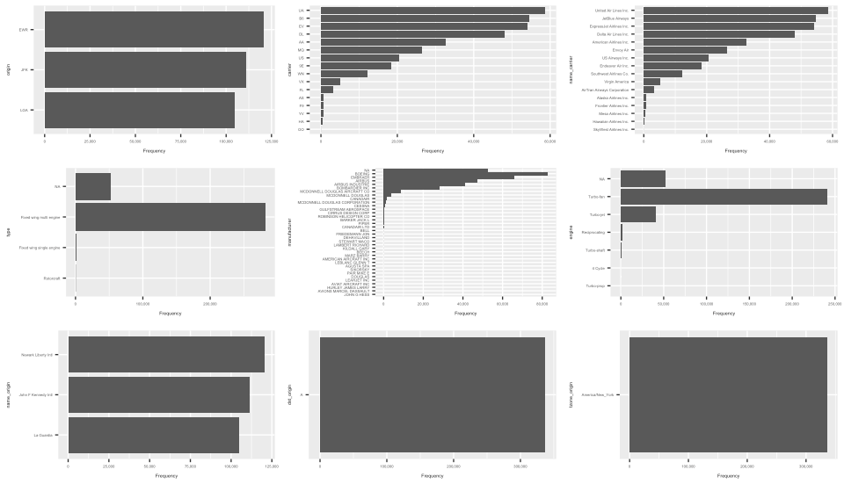
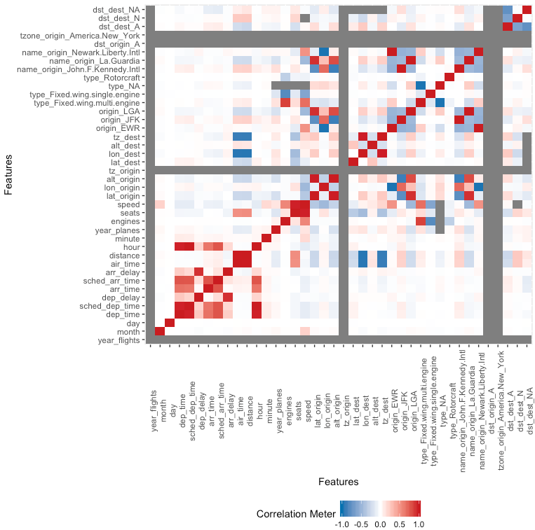
Data collection and data exploration
Often data is stored at multiple location in different data sources, R has a library for almost all major data source connections
Data manipulaion is fun with Tidyverse
Super easy to get first insights from data
Library(DataExplorer)
Create_report(MyData)
HTML report with all major statistics
Graphs from the vignettes of the package

Slide 6

Modeling and data preparation
How to simplify the task?
Not a single package for modeling and data preparation (like scikit-learn in Python)
Everything is implemented in different packages having different syntaxes
We want to test several models but it can easily become a pain at the end
Quality of documentation varies
A common solution for this problems is the Caret package that is a set of functions for:
data splitting
pre-processing
feature selection
model tuning using resampling
variable importance estimation

Slide 7

Modeling and data preparation MLR for the rescue
MLR package (Machine Learning in R):
Similar to caret but younger, feels a superset of caret
Intuitive interface, especially if you used Python before
Active community around it
Good documentation
Model building just in 6 lines:
task = makeClassifTask(data = data, target = "target_var")
lrn_rpart = makeLearner("classif.rpart", predict.type = "prob")
train.set = sample(n, size = 0.8*n)
test.set = setdiff(1:n, train.set)
model_rpart = train(lrn_rpart, task, subset = train.set)
pred_rpart = predict(model_rpart, task = task, subset = test.set)

Slide 8

Modeling and data preparation
With MLR similarly easy to:
Sampling (even with SMOTE) –> important for imbalanced datasets
Grid-search for hyperparameter tuning -> provide best models
Evaluate results (several metrics built in)
Recommendation: use H2O models
Can be used with MLR
Provide good results
Train fast (vital for grid search)
Stabil library with bright future vision
Cross-platform models

Slide 9

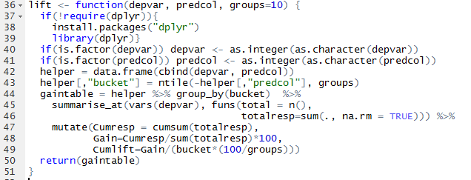
Modeling and data preparation Challanges with MLR
It is still just a wrapper around libraries working differently (huge variance in performance of the models)
Sometimes you can stuck in problems finding no anwsers in documentation (i.e. how to save a H2O model) – but StackOverflow is your friend
Some evluation metric frequently used in business (i.e. Lift) is missing

Slide 10
Deployment Challanges with MLR
How to put your model into production?
How to transfer a model from one ecosysem to the other?
Docker containers
Packrat: creating a specific environment for each project
Checkpoint: referencing of daily snapshots of MRAN (Microsoft’s CRAN equialent)
How to automataize running and log errors?
No built-in logging library
Several community made solution
Logging: nice logging library that emulates the Python logging package (that emulates the Java logging package)

Slide 11
How to improve further?
How to operate your model in a transparent way
Many model must be transparent in the insurance sector due to the requirements of the regulator
In other cases transparency will support our colleagues to build trust towards the predicitions of the model
Transparency (i.e. feature importance, partial dependence plots) are good for model validation
Transparency (i.e. LIME or SHAP values) is good for explaining single predictions
LIME package plays well with H2O models
We did not find SHAP implementations

Slide 12

Conclusion and remarks
R can be a valueable tool for analytics in the insurance sector too and can help us to answer traditional business problems better
R is extremely versatile
There are many ways to success in R
The real power of R is the community around it:
Creating awsome packages
Helping each other to solve problems
Meeting with each other and sharing information

Slide 13

Questions

Slide 14
Viktor.Tisza@generali.com

